Slide 1
Chapter#1
Kashif Bashir

Slide 2
TCP/IP Review
The TCP/IP Protocol Layers
The IP Packet Header
IP Addresses
ARP
ICMP
The Host-to-Host Layer
The purpose of this chapter is to examine the details of the protocols that enable, control, or contribute to the routing of TCP/IP.
Kashif Bashir

Slide 3
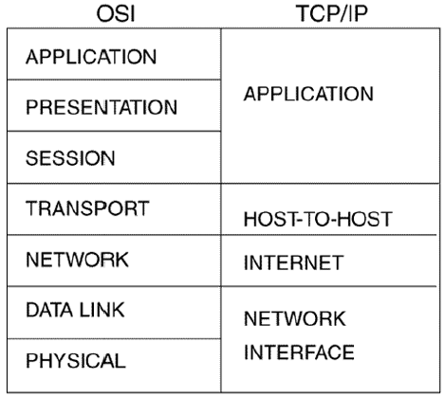
The TCP/IP Protocol Layers
Kashif Bashir

Slide 4
The physical layer
The protocols of this layer fall within four categories that together describe all aspects of physical media:
Electrical/optical protocols describe signal characteristics such as voltage or photonic levels, bit timing, encoding, and signal shape.
Mechanical protocols are specifications such as the dimensions of a connector or the metallic makeup of a wire.
Functional protocols describe what something does. For example, "Request to Send" is the functional description of pin 4 of an EIA-232-D connector.
Procedural protocols describe how something is done. For example, a binary 1 is represented on an EIA-232-D lead as a voltage more negative than –3 volts.
Kashif Bashir

Slide 5
The data link layer
how the medium is accessed and shared, how devices on the medium are identified, and how data is framed before being transmitted on the medium. Examples of data link protocols are IEEE 802.3/Ethernet, IEEE 802.5/Token Ring, and FDDI.
Kashif Bashir

Slide 6
The internet layer
corresponding to the OSI network layer, is primarily responsible for enabling the routing of data across logical internetwork paths.
Kashif Bashir

Slide 7
The host-to-host layer
Corresponding to the OSI transport layer, specifies the protocols that control the internet layer, much as the data link layer controls the physical layer.
the transport layer controls traffic on the logical link the end-to-end connection of two devices whose logical connection traverses a series of data links.
Kashif Bashir

Slide 8
The application layer
The most common services of the application layer provide the interfaces by which user applications access the network.
Kashif Bashir

Slide 9
IP Addresses
IP addresses are 32 bits long; like all network-level addresses, they have a network portion and a host portion.
The network portion uniquely identifies the data link (that is, the network) and is common to all devices attached to the network.
The host portion uniquely identifies a particular device attached to the network.
Kashif Bashir

Slide 10
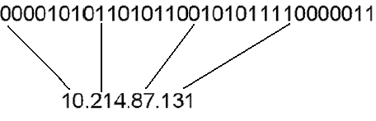
IP Addresses
The dotted-decimal format is a convenient way to write IP addresses, but it should not be confused with what the router (or host) sees—a 32-bit string.
Kashif Bashir

Slide 11
The First Octet Rule
Without putting too fine a point on it, it can be said that there are three sizes of internetworks as measured by the number of hosts: big, medium, and small.
Big internetworks, by definition, have a huge number of hosts. Relatively few big internetworks exist.
Small internetworks are just the opposite. Each one is small because it has a small number of hosts; a huge number of small internetworks exist.
Medium internetworks are just that: a medium number of them (in relation to big and small ones) and a medium number of hosts in each one.
Kashif Bashir

Slide 12
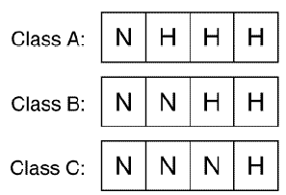
The First Octet Rule
Class A, B, and C IP address formats.
Kashif Bashir

Slide 13
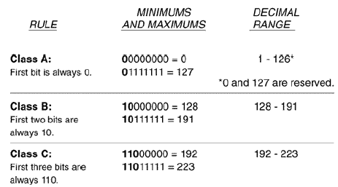
The First Octet Rule
No. of Hosts
2^24= 16,777,216
2^16=65536
2^8= 256
Kashif Bashir

Slide 14
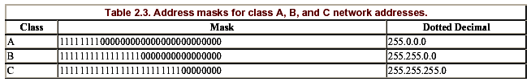
Address Masks
Kashif Bashir

Slide 15
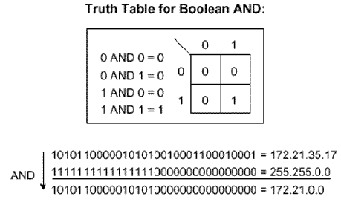
Address Masks
Each bit of this class B address is ANDed with the corresponding bit of the address mask to derive the network address.
Kashif Bashir

Slide 16
Address Masks
An address and mask are assigned to an interface of a Cisco router (in this example, the E0 interface) by means of the following commands:
Smokey(config)# interface ethernet 0
Smokey(config-if)# ip address 172.21.35.17 255.255.0.0
Kashif Bashir

Slide 17
Subnets and subnet Masks
If a separate class A, B, or C address were assigned to each data link, less than 17 million data links could be addressed before all IP addresses were depleted. This approach is obviously impractical.
The only way to make class A, B, or C addresses practical is by dividing each major address, such as 172.21.0.0, into subnetwork addresses. Recall two facts:
The host portion of an address can be used as desired.
The network portion of an IP address is determined by the address mask assigned to that interface.
Kashif Bashir

Slide 18
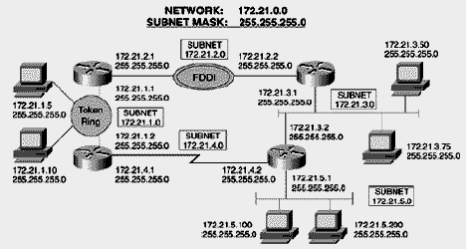
Subnets and subnet Masks
Subnet masks allow a single network address to be used on multiple data links by "borrowing“ some of the host bits for use as subnet bits.
Kashif Bashir

Slide 19
Subnets and subnet Masks
The IP address now has three parts: the network part, the subnet part, and the host part. The address mask is now a subnet mask, or a mask that is longer than the standard address mask. The first two octets of the address will always be 172.21, but the third octet—whose bits are now subnet bits instead of host bits— may range from 0 to 255. The internetwork in Figure 2.12 has subnets 1, 2, 3, 4, and 5 (172.21.1.0 through 172.21.5.0). Up to 256 subnets may be assigned under the single class B address, using the mask shown.
Kashif Bashir

Slide 20
Subnets and subnet Masks
All routing protocols can not support subnet addresses in which the subnet bits are all zeros or all ones.
The reason is that these protocols, called classful protocols, cannot differentiate between an all-zero subnet and the major network number. For instance, subnet 0 in Figure 2.13 would be 172.21.0.0; the major IP address is also 172.21.0.0. The two cannot be distinguished without further information.
Kashif Bashir

Slide 21



Subnets and subnet Masks
Likewise, classful routing protocols cannot differentiate a broadcast on the all-ones subnet from an all subnets broadcast address. For example, the all-ones subnet in Figure 2.13 would be 172.21.255.0. For that subnet, the all-hosts broadcast address would be 172.21.255.255, but that is also the broadcast for all hosts on all subnets of major network 172.21.0.0.
The subnet mask may be represented in any of three formats—dotted decimal, bitcount, and hexadecimal.
Kashif Bashir

Slide 22
Designing Subnets
When designing subnets and their masks, the number of available subnets under a major network address and the number of available hosts on each subnet are both calculated with the same formula:
2^{n} – 2
where n is the number of bits in the subnet or host space. For example, given a class A address of 10.0.0.0, a subnet mask of 10.0.0.0/16 (255.255.0.0) means that the 8-bit subnet space will yield 2⁸ – 2 = 254 available subnets and 2¹⁶ – 2 = 65,534 host addresses available on each of those subnets.
Kashif Bashir

Slide 23
Designing Subnets
A stepwise method for designing subnets
Determine how many subnets are required and how many hosts per subnet are required.
Use the 2^{n} – 2 formula to determine the number of subnet bits and the number of host bits that will satisfy the requirements established in step 1.
Working in binary, determine all available bit combinations in the subnet space; in each instance, set all the host bits to zero. Convert the resulting subnet addresses to dotted decimal. These are the subnet addresses.
4. For each subnet address, again working in binary, write all possible bit combinations for the host space without changing the subnet bits. Convert the results to dotted decimal; these are the host addresses available for each subnet.
Kashif Bashir

Slide 24
Designing Subnets
A class B address across 500 data links, each with a maximum of 100 hosts?
This requirement is easily met, but only by using nine bits in the subnet field: 2⁹ – 2 = 510 available subnets, leaving seven bits for the host field, and 2⁷ – 2 = 126 available hosts per subnet.
Kashif Bashir

Slide 25
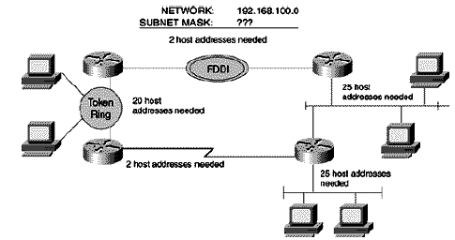
Designing Subnets
Example:
Step 1:
The network from Figure but with a class C mask assigned. Subnetting an entire octet will not work here; there would be no space left for host bits.
Kashif Bashir

Slide 26
Designing Subnets
Step2:
Applying the 2^{n} – 2 formula, three subnet bits and five host bits will satisfy the requirements: 2³ – 2 = 6 and 2⁵ – 2 = 30. A class C mask with three bits of subnetting is represented as 255.255.255.224 in dotted decimal.
Kashif Bashir

Slide 27
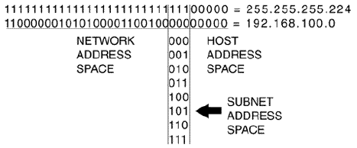
Designing Subnets
Step 3:
The subnet bits are derived by marking the masked subnet bit space and then writing all possible bit combinations in the space by counting up from zero in binary.
Kashif Bashir

Slide 28
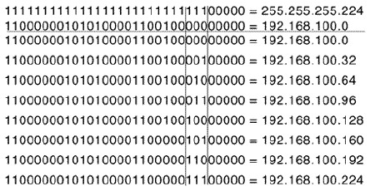
Designing Subnets
Step 3: Continue..
Figure.The subnet addresses are derived by filling in the network address to the left of the subnet space, setting all host bits to zero to the right of the subnet space, and converting the results to dotted decimal.
Kashif Bashir

Slide 29
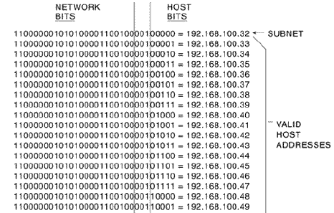
Designing Subnets
The host addresses for a subnet are derived by writing all possible bit combinations in the host space. These are the host bits for subnet 192.168.100.32.
Kashif Bashir

Slide 30
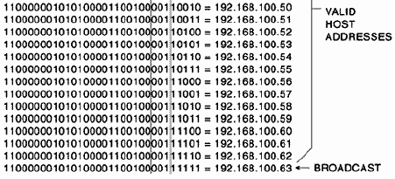
Designing Subnets
Step 4: Continue..
Kashif Bashir

Slide 31
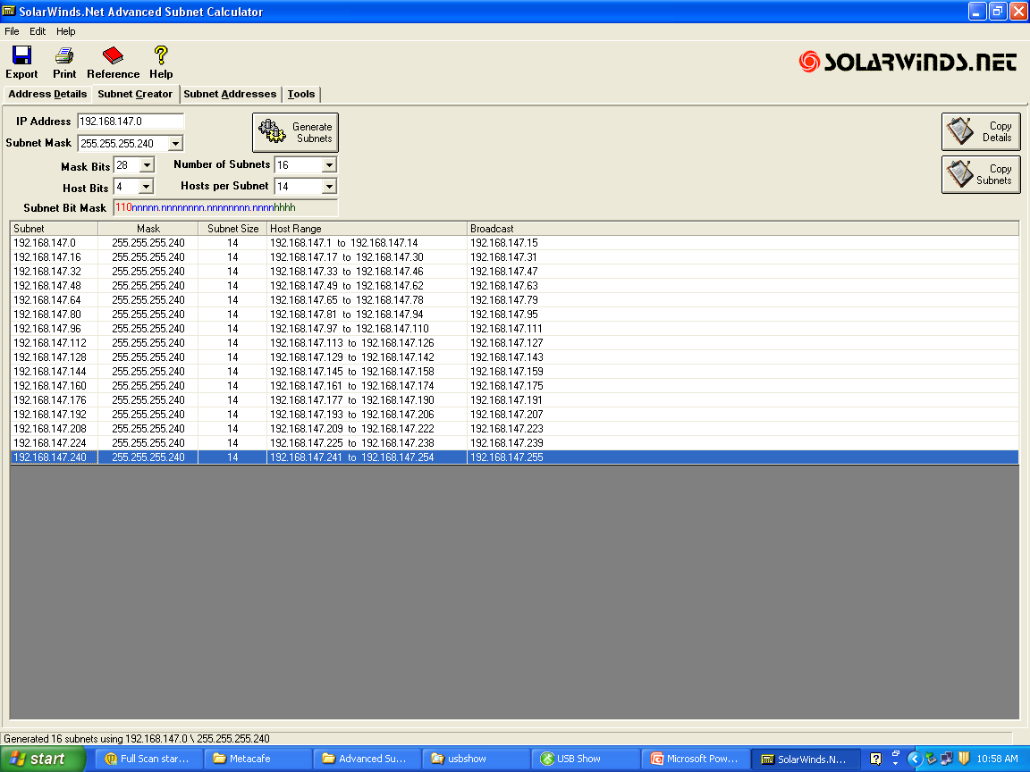
Use a 28-bit mask to derive the available subnets of 192.168.147.0. Derive the available host addresses of each subnet.
Kashif Bashir

Slide 32
Use a 20-bit mask to derive the available subnets of 10.0.0.0. Derive the available host addresses of each subnet.
10.0.0.0 255.255.240.0 4094 10.0.0.1 to 10.0.15.254 10.0.15.255
10.0.16.0 255.255.240.0 4094 10.0.16.1 to 10.0.31.254 10.0.31.255
10.0.32.0 255.255.240.0 4094 10.0.32.1 to 10.0.47.254 10.0.47.255
10.0.48.0 255.255.240.0 4094 10.0.48.1 to 10.0.63.254 10.0.63.255
10.0.64.0 255.255.240.0 4094 10.0.64.1 to 10.0.79.254 10.0.79.255
10.0.80.0 255.255.240.0 4094 10.0.80.1 to 10.0.95.254 10.0.95.255
10.0.96.0 255.255.240.0 4094 10.0.96.1 to 10.0.111.254 10.0.111.255
10.0.112.0 255.255.240.0 4094 10.0.112.1 to 10.0.127.254 10.0.127.255
10.0.128.0 255.255.240.0 4094 10.0.128.1 to 10.0.143.254 10.0.143.255
10.0.144.0 255.255.240.0 4094 10.0.144.1 to 10.0.159.254 10.0.159.255
10.0.160.0 255.255.240.0 4094 10.0.160.1 to 10.0.175.254 10.0.175.255
10.0.176.0 255.255.240.0 4094 10.0.176.1 to 10.0.191.254 10.0.191.255
10.0.192.0 255.255.240.0 4094 10.0.192.1 to 10.0.207.254 10.0.207.255
10.0.208.0 255.255.240.0 4094 10.0.208.1 to 10.0.223.254 10.0.223.255
10.0.224.0 255.255.240.0 4094 10.0.224.1 to 10.0.239.254 10.0.239.255
10.255.144.0 255.255.240.0 4094 10.255.144.1 to 10.255.159.254 10.255.159.255
10.255.160.0 255.255.240.0 4094 10.255.160.1 to 10.255.175.254 10.255.175.255
10.255.176.0 255.255.240.0 4094 10.255.176.1 to 10.255.191.254 10.255.191.255
10.255.192.0 255.255.240.0 4094 10.255.192.1 to 10.255.207.254 10.255.207.255
10.255.208.0 255.255.240.0 4094 10.255.208.1 to 10.255.223.254 10.255.223.255
10.255.224.0 255.255.240.0 4094 10.255.224.1 to 10.255.239.254 10.255.239.255
10.255.240.0 255.255.240.0 4094 10.255.240.1 to 10.255.255.254 10.255.255.255
Kashif Bashir

Slide 33
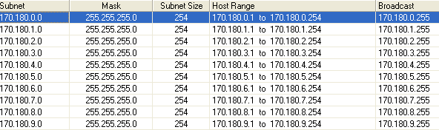
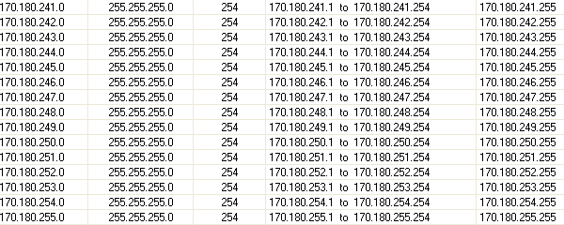
Use a 24-bit mask to derive the available subnets of 170.180.0.0. Derive the available host addresses of each subnet.
Ans: No. of subnets = 256, No. of Hosts per subnet = 254.
Kashif Bashir

Slide 34
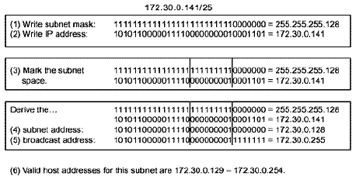
Troubleshooting a Subnets Mask
Given an IP address and a subnet mask, follow these steps to find the subnet, the broadcast, and the host addresses.
Kashif Bashir

Slide 35
Address Resolution Protocol
The term address resolution refers to the process of finding an address of a computer in a network.
The address is "resolved" using a protocol in which a piece of information is sent by a client process executing on the local computer to a server
The ARP Request packet is then encapsulated in a frame with the sender's MAC address as the source and a broadcast address for the destination
Kashif Bashir

Slide 36
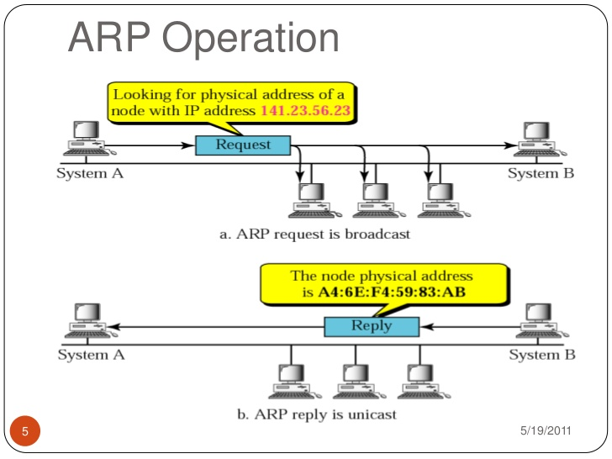
Kashif Bashir

Slide 37
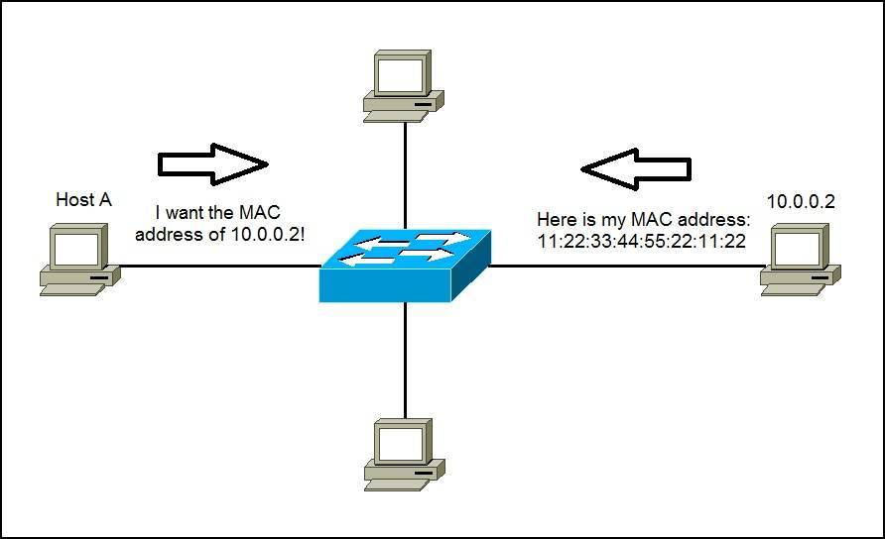
Kashif Bashir

Slide 38
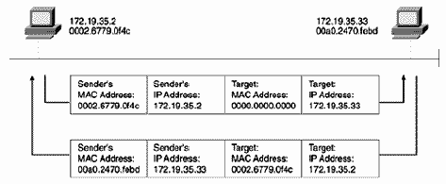
ARP Continue..
The broadcast address means that all devices on the data link will receive the frame and examine the encapsulated packet. All devices except the target will recognize that the packet is not for them and will drop the packet. The target will send an ARP Reply to the source address, supplying its MAC address
Kashif Bashir

Slide 39
Proxy ARP
Proxy ARP is a method by which routers may make themselves available to hosts.
In Figure2.26, The router is configured with a 28-bit mask (four bits of subnetting for the class C address), but the hosts are all configured with 24-bit, default class C mask. As a result, the hosts will not be aware that subnets exist. Host 192.168.20.66, wanting to send a packet to 192.168.20.25, will issue an ARP Request.
The router, recognizing that the target address is on another subnet, will respond with its own hardware address. Proxy ARP makes the subnetted network topology transparent to the hosts.
Proxy ARP is enabled by default on Cisco routers and may be disabled on a per interface basis with the command no ip proxy-arp.
Kashif Bashir
Notes:
Advantages of Proxy ARP
The main advantage of proxy ARP is that it can be added to a single router on a network and does not disturb the routing tables of the other routers on the network.
Proxy ARP must be used on the network where IP hosts are not configured with a default gateway or do not have any routing intelligence.
Disadvantages of Proxy ARP
Hosts have no idea of the physical details of their network and assume it to be a flat network in which they can reach any destination simply by sending an ARP request. But using ARP for everything has disadvantages. These are some of the disadvantages:
It increases the amount of ARP traffic on your segment.
Hosts need larger ARP tables in order to handle IP-to-MAC address mappings.
Security can be undermined. A machine can claim to be another in order to intercept packets, an act called "spoofing."
It does not work for networks that do not use ARP for address resolution.
It does not generalize to all network topologies. For example, more than one router that connects two physical networks.

Slide 40
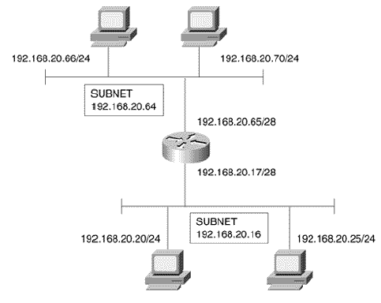
Proxy ARP
Proxy ARP enables the use of transparent subnets.
Kashif Bashir
Notes:
Proxy ARP is the technique in which one host, usually a router, answers ARP requests intended for another machine. By "faking" its identity, the router accepts responsibility for routing packets to the "real" destination. Proxy ARP can help machines on a subnet reach remote subnets without the need to configure routing or a default gateway.

Slide 41
Reverse ARP
Instead of mapping a hardware address to a known IP address, Reverse ARP (RARP) maps an IP address to a known hardware address.
Some devices, such as diskless workstations, may not know their IP address at startup. RARP may be programmed into firmware on these devices, allowing them to issue an ARP Request that has their burned-in hardware address.
The reply from a RARP server will supply the appropriate IP address.
Kashif Bashir

Slide 42
ICMP
The Internet Control Message Protocol, or ICMP, specifies a variety of messages whose common purpose is to manage the internetwork. ICMP messages may be classified as either error messages or queries and responses.
The packets are identified by type; many of the packet types have more specific types, and these are identified by the code field.
Table 2.5 lists the various ICMP packet types and their codes.
Kashif Bashir

Slide 43
The Host-to-Host Layer
The internet layer is responsible for the logical paths between networks, the host-to-host layer is responsible for the full logical path between two hosts on disparate networks.
From another viewpoint, the host-to-host layer is an interface to the lower layers of the protocol suite, freeing applications from any concern about how their data is actually being delivered.
The two primary services offered by the host-to-host layer are TCP and UDP.
Kashif Bashir

Slide 44
TCP
The Transmission Control Protocol provides applications with a reliable, connection-oriented service. In other words, TCP provides the appearance of a point-to-point connection.
Point-to-point connections have two characteristics:
  They have only one path to the destination. A packet entering one end of the connection cannot become lost, because the only place to go is the other end.
  Packets arrive in the same order in which they are sent.
Kashif Bashir

Slide 45
TCP
The internet layer does not guarantee that all packets will take the same route, and therefore there is no guarantee that they will arrive in the same sequence and time intervals as they were sent, or that they will arrive at all.
A telephone call is connection-oriented service. Data must arrive sequentially and reliably, or it is useless. Like a telephone call, TCP must first establish a connection, then transfer data, and then perform a disconnect when the data transfer is complete.
Kashif Bashir

Slide 46
UDP
User Datagram Protocol provides a connectionless, best-effort packet delivery service.
The advantage of UDP, however, is that no time is spent
setting up a connection—the data is just sent.
Kashif Bashir

Slide 47
Looking Ahead
The focus of this chapter has largely been on the mechanisms by which a device's internet layer (or OSI network layer) identifies itself and how it maps to the network interface (or OSI data link) layer.
Internet layer functions that are important to routing were also examined.
The following chapter examines the routing function and the information a router requires to perform that function.
Kashif Bashir

Slide 48
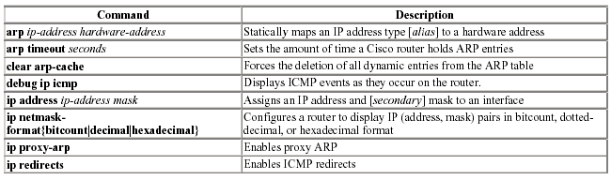
Summary Table: Chapter 2 Command Review
Kashif Bashir

Slide 49
Thank you
Kashif Bashir

